Slide 1



Efficient Reinforcement of Bipartite Networks at Billion Scale
Yizhang He, Kai Wang, Wenjie Zhang, Xuemin Lin, Ying Zhang
Notes:
Good afternoon everyone.
It is my pleasure and honor here to present our work, {titile}.
I am currently a PhD student from UNSW.
My co-authors are Dr Kai Wang, Professort Wenjie, Prof Xuemin Lin and Prof Ying Zhang

Slide 2
Outline
Introduction
Solutions
Experiments
Conclusion
Notes:
Give you a brief intro to bipartite networks, cohesive subgraph models, and formally define the anchored abcore problem and discuss its complexity and its applications.
Then I will present my solutions to the anchorted \abcore problem.
After that I will present the results of my experiments which evaluate the effectiveness and efficiency of my solutions.
In the end I will summarize my findings and discuss possible future research directions.

Slide 3











Introduction
Users:
Items:
An example of bipartite graph
Notes:
## intro to bipartite graph and background of network reinforcement
Our recent research is focused on bipartite graphs, which are a special class of the graph family, where the vertices are partitioned into two sets. Each edge in the bipartite graph connects a vertex from one set to a vertex in the other set. A real-world example of bipartite graph is the user-item network on e-commerce platforms like Amazon and Ebay. As shown here, the upper vertices represent users and the lower vertices are products listed on these websites. Each edge indicates a type of interaction, e.g. purchasing, reviewing, and liking.
It is important the maintain the activity level of these networks. We want the users stay in the network in the long run.
The underlying logic is that people are more willing to be involved in a thriving community than an inactive one.
(It is said that when Alibaba was first introduced, the first batch of orders were submitted by internal staff, just to show the public the legitimacy and reliability of their service. This was probably their first attempt in maintaining/improving the stability of their user-item network. )
In this work, we aim to adopt cohesive subgraph models to reinforce bipartite networks.

Slide 4
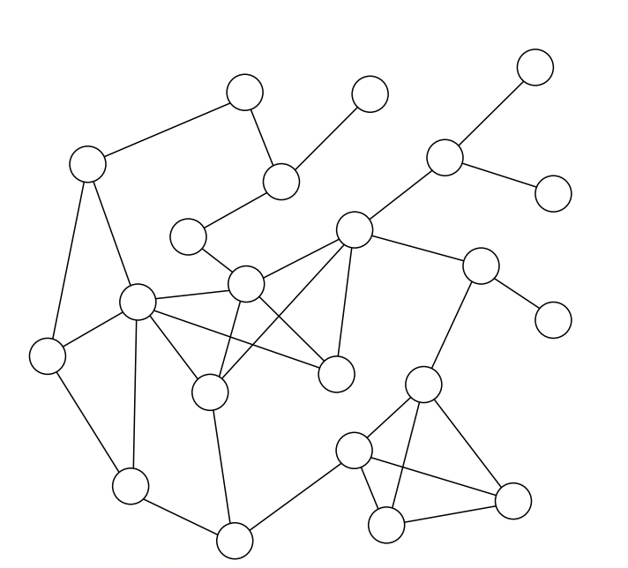
Introduction
K-core: the k-core of G = (V, E) is a maximal connected subgraph of G in which every vertex v has at least degree k.
Fast and easy to compute
Scalable to large graphs
The original Graph G
Seidman, Stephen B. "Network structure and minimum degree." Social networks 5.3 (1983): 269-287.
Notes:
Before introducing our model, let’s review some existing work of network reinforcement on general graphs.
K-core is a representative cohesive subgraph model on general graph, which requires each vertex to have at least k neighbors in the subgraph.
It is fast and easy to compute the kcore for all values of k in time linear to the graph size. So it is easily scalable to large graphs.

Slide 5
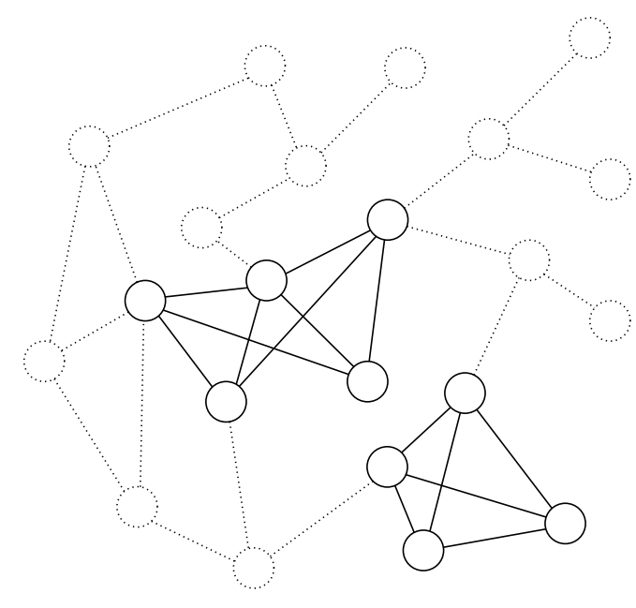
Introduction
K-core: the k-core of G = (V, E) is a maximal connected subgraph of G in which every vertex v has at least degree k.
The maximum equilibrium in a simultaneous-move game
Models the “peer influence” in social networks
The 3-core of G
Chwe, Michael Suk-Young. "Communication and coordination in social networks." The Review of Economic Studies 67.1 (2000): 1-16.
Notes:
For example here the grey vertices induce a 3-core, where each vertex has at least 3 neighbors.
Recent findings from economics and game theory establish that k-core can be used to model peer influence on social networks.
For example, in a game where each vertex can simultaneously decide WHETHER or Not to stay in the network.
Assume that a vertex stays when at least k neighbors stay.
It’s like going to a concert, You don’t wanna go unless you have at least k friends going with you.
The k-core represents maximum equilibrium of this game, which means that the state represented by the k-core is very stable.

Slide 6
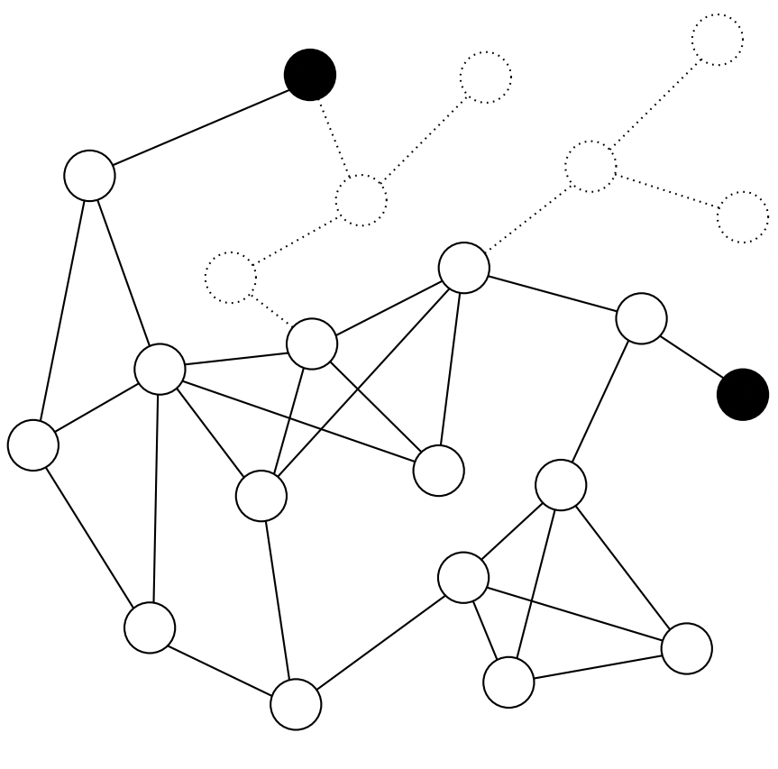
Introduction
Anchored K-core:
Relaxes the degree constraints for some ”anchor” vertices
Maximize the size of the resulting k-core
The anchored 3-core
Bhawalkar, Kshipra, et al. "Preventing unraveling in social networks: the anchored k-core problem." SIAM Journal on Discrete Mathematics 29.3 (2015): 1452-1475.
Notes:
To reinforce this network, we aim to expand the stable unit represented by k-core.
To do so, the anchored k-core model is proposed, which relaxes the degree constraint on some anchor vertices.
In real applications, anchoring some vertices is equivalent to giving them extra incentives to stay in the network.
Maybe give them membership premiums, discounts, and privileges to make sure that they will stay in the network.
Consequently, anchoring a few vertices will cause many more vertices to enter the stable structure of k-core.
These vertices are called followers. It is perceived that they “follow” the actions of the “anchors” and decide to stay in the network.
For example, the red vertices are anchors and the blue vertices are the followers due to these anchors.

Slide 7
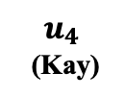
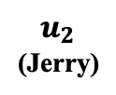
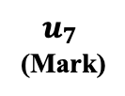
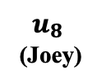
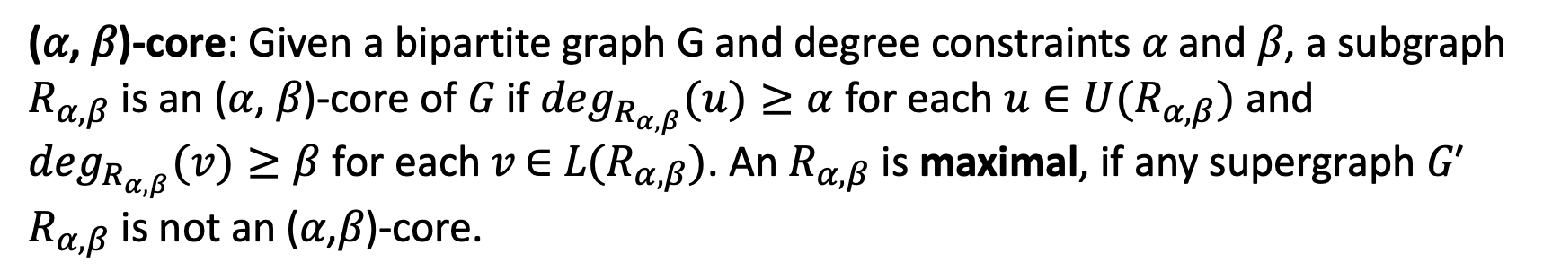
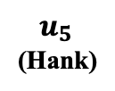
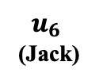
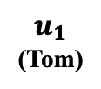
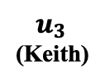
Introduction
(𝛼, 𝛽)-core: Given a bipartite graph G and degree constraints 𝛼 and 𝛽, a subgraph $R_{α,β}$ is an (𝛼, 𝛽)-core of 𝐺 if$\deg_{R_{α,β}}(u)≥α$ for each$u∈U(R_{α,β})$ and $\deg_{R_{α,β}}(v)≥β$ for each 𝑣 ∈ 𝐿$(R_{α,β})$. An $R_{α,β}$ is maximal, if any supergraph 𝐺′ $R_{α,β}$ is not an (𝛼,𝛽)-core.
$$u_{1}$$
(Tom)
$$u_{2}$$
(Jerry)
$u_{3}$ (Keith)
$$u_{4}$$
(Kay)
$$u_{5}$$
(Hank)
$$u_{6}$$
(Jack)
$$u_{7}$$
(Mark)
$$u_{8}$$
(Joey)
The (4, 3)-core of G
Notes:
Motivated by existing work, we use a representative cohesive subgraph model, abcore, to reinforce bipartite networks.
It is a generalization of the classic k-core model and it can impose different degree constraints on upper and lower vertices.
It requires upper to have xxx and lower to have ….
As shown here, the xxx is a (4,3)-core, because …..
We believe that in cohesive subgraphs, the minimum level node engagement is guaranteed so such subgraphs are structurally more stable. We can reinforce the bipartite network by maximizing the size of a cohesive subgraph.
We use a representative model, alpha beta core and aim to maximize such a subgraph. By relaxing the degree constraints on some selected vertices.

Slide 8
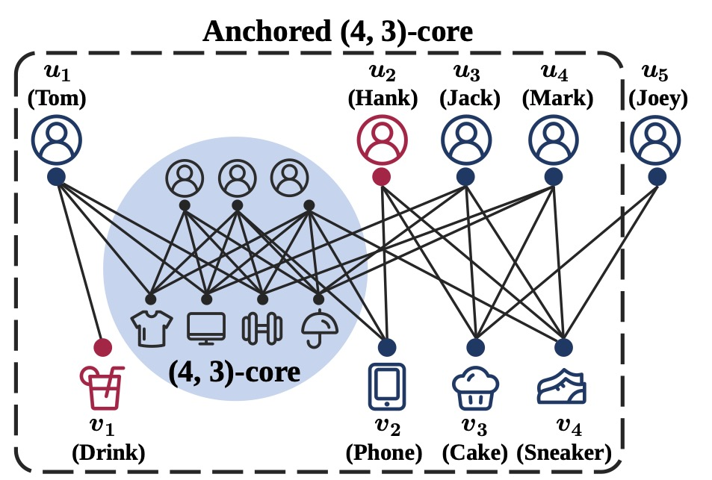
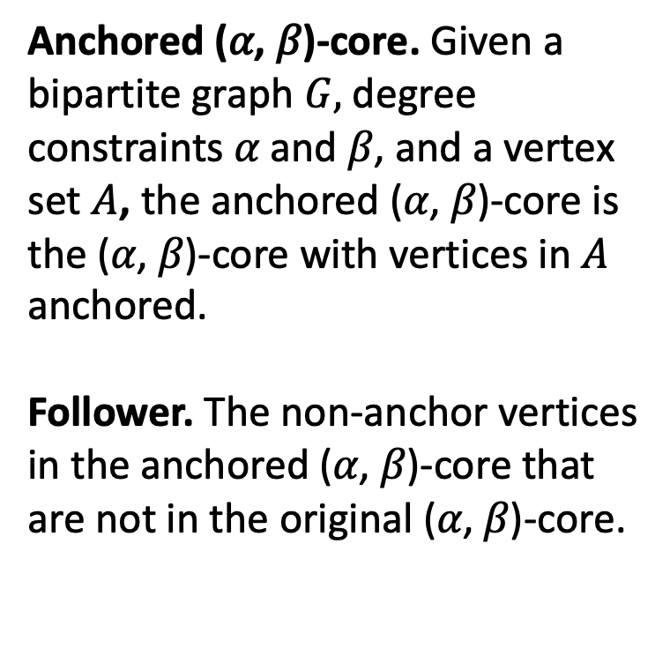
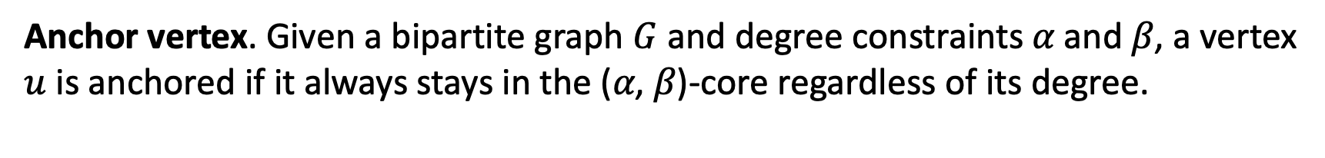
Introduction
Anchor vertex. Given a bipartite graph $G$ and degree constraints 𝛼 and 𝛽, a vertex $u$ is anchored if it always stays in the (𝛼, 𝛽)-core regardless of its degree.
Anchored (𝛼, 𝛽)-core. Given a bipartite graph $G,$degree constraints 𝛼 and 𝛽, and a vertex set $A$, the anchored (𝛼, 𝛽)-core is the (𝛼, 𝛽)-core with vertices in $A$ anchored.
Follower. The non-anchor vertices in the anchored (𝛼, 𝛽)-core that are not in the original (𝛼, 𝛽)-core.
Notes:
Just like in the anchored kcore model. If a vertex is anchored, its degree is set to positive infinity and always stay in the abcore.
For example, in the graph shown on the right. the area is shade is again, the (4,3)-core. By placing anchors are u2 and v1, the whole subgraph
Wrapped in dashed lines is the anchored (4,3)-core.
The motivation behind this model is that
(the cohesive subgraph like abcore and kcore are stable components of the original graph.)
We believe that in cohesive subgraphs, the minimum level node engagement is guaranteed so such subgraphs are structurally stable. We can reinforce the bipartite network by maximizing the size of a cohesive subgraph.

Slide 9
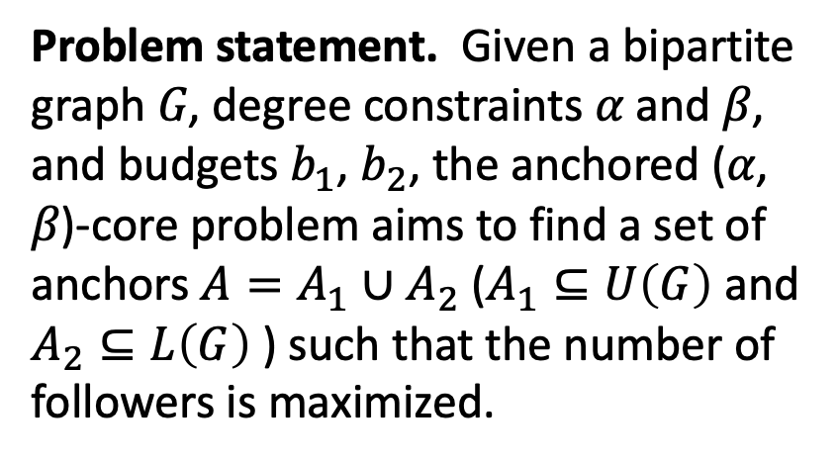
Introduction
Problem statement. Given a bipartite graph 𝐺, degree constraints 𝛼 and 𝛽, and budgets $b_{1}$, $b_{2}$, the anchored (𝛼, 𝛽)-core problem aims to find a set of anchors $A=A_{1}∪A_{2}$ ($A_{1}⊆U\left(G\right)$ and $A_{2}⊆L\left(G\right)$ ) such that the number of followers is maximized.
Notes:
The anchored abcore problem is defined as such:
We are given a budget b1 on the number of upper anchors and budget b2 on the number of lower anchors.
We want to find the anchor set such that the resulting anchored abcore is maximized.
Or equivalently, the number of followers is maximized.

Slide 10
Related Works
Network reinforcement
- anchored k-core
- anchored and collpased coreness problem
- anchored and collapsed k-truss problem
Cohesive subgsraph models on bipartite graphs
- core-like models: (α, β)-core
- truss-like model: k-bitruss/k-wing
- clique-like models: biclique
Notes:
Recent attempts other than the anchored kcore model, we have:
Collpased kcore model, anchored coreness model, and so on.
Bipartite graphs, many cohesive subgraph models exsit. Like k-bitruss, and all variants of bicliques.
K-bitruss is an edge-centric model. and bicliques are expansive to compute.
We are the first the study the network reinforcement using a cohesive subgraph model on bipartite graphs.

Slide 11
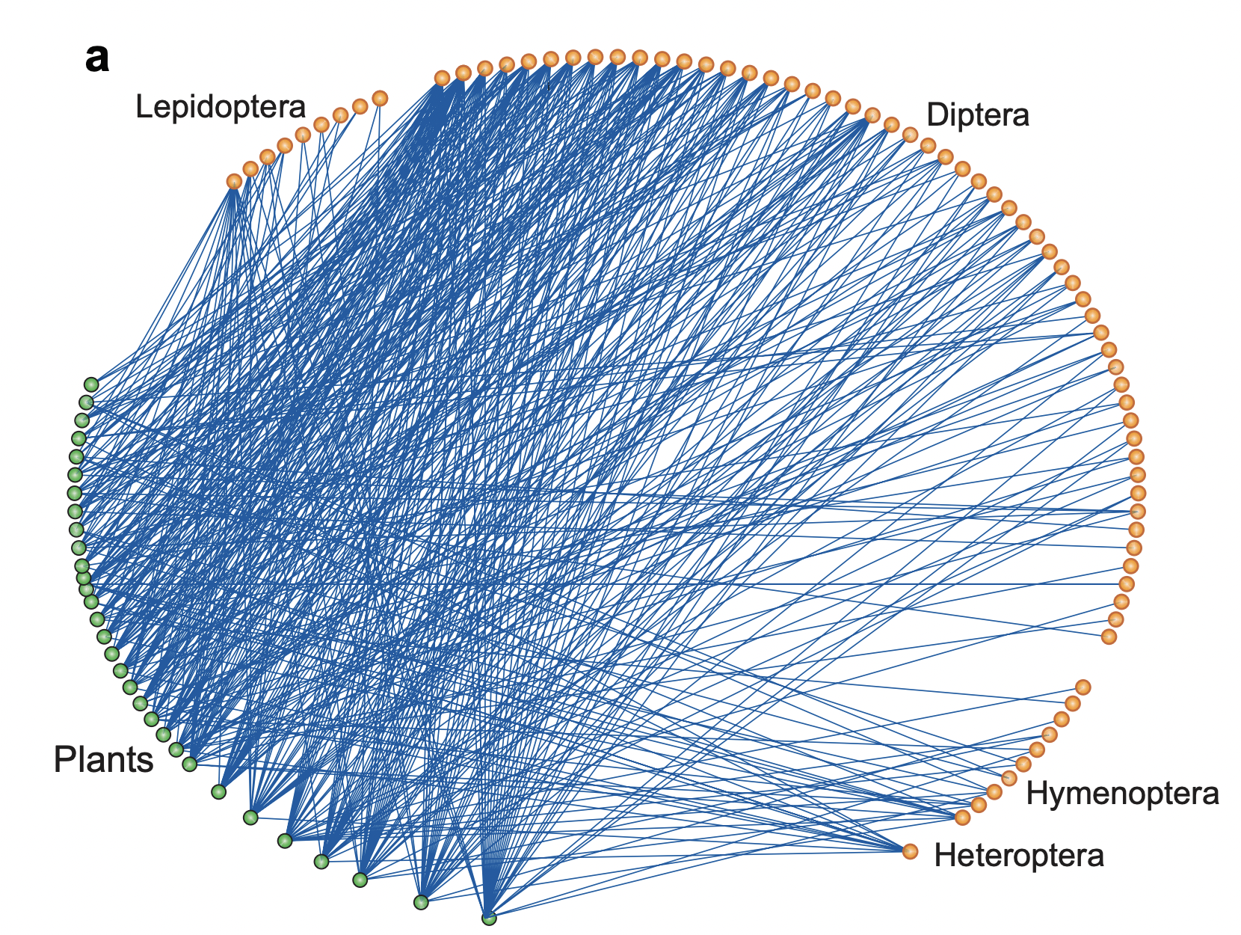
Applications
Maintaining social groups
Reinforcing mutualistic networks
An example of pollination network
Bascompte, Jordi, and Pedro Jordano. "Plant-animal mutualistic networks: the architecture of biodiversity." Annu. Rev. Ecol. Evol. Syst. 38 (2007): 567-593.
Notes:
Solving the anchored abcore problem has many applications.
In the aforementioned user-item network, we can provide membership privileges or discounts to certain selected “anchor” users and keep them in the network. In this way we can have a thriving e-commerce community in the long run which attracts more users and generate more revenue.
Mutualistic network is another important class of bipartite networks, which can model the reciprocal relationships among some plants and animals. They rely on each other to survive.
By improving the habitat of certain species, we can improve the stability of the ecosystem and make these species more resilient to extinction.
A plant-pollinator network in Zackenberg Arctic tundra, Greenland that illustrates the pattern of interactions among insects (orange dots) and plants ( green dots)

Slide 12

Problem Complexity
NP-hardness
Inapproximability
Not submodular or super-modular
Reduction to set cover when $α=3$ and $β=2$
Notes:
Our problem is a generalization to the classic anchored kcore problem. Thus, it is also NP-hard in most cases.
However, its hardnesss result is a bit more complicated due to more parameter combination.s
Compare to set cover to derive hardness results.
We aim to optimize an objective function over some sets. When such an objective function is submodular or supermodular, many approaches can be applied. However, we have shown that such a objective function is neither, due to the complexity of the graph structure.

Slide 13
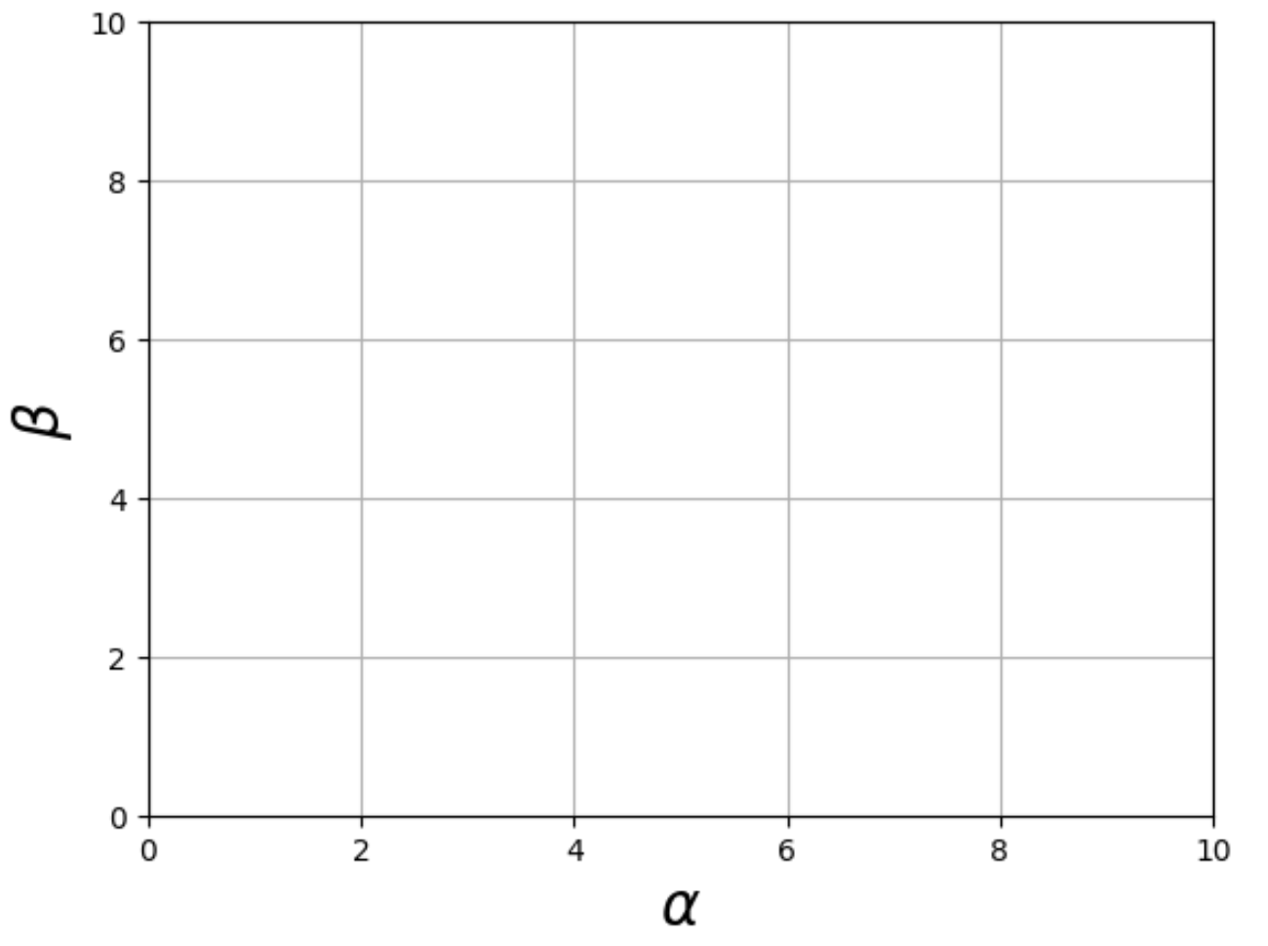
Problem Complexity
NP-hardness
Inapproximability
Not submodular or super-modular
Polynomial-time:
NP-complete:
NP-hard:
Summary of hardness results
Notes:
When both a and b are larger than 2, the problem is NP-hard.
When either a and b is 1 and the other is larger than 2, the problem is a special case of the set cover problem and is NP-complete.
When both a and b does not exceed 2, the problem is p-time solvable.
We also prove that the objective function is not sub-super modular. Which eliminates the possibility of submodular optimization approaches.

Slide 14
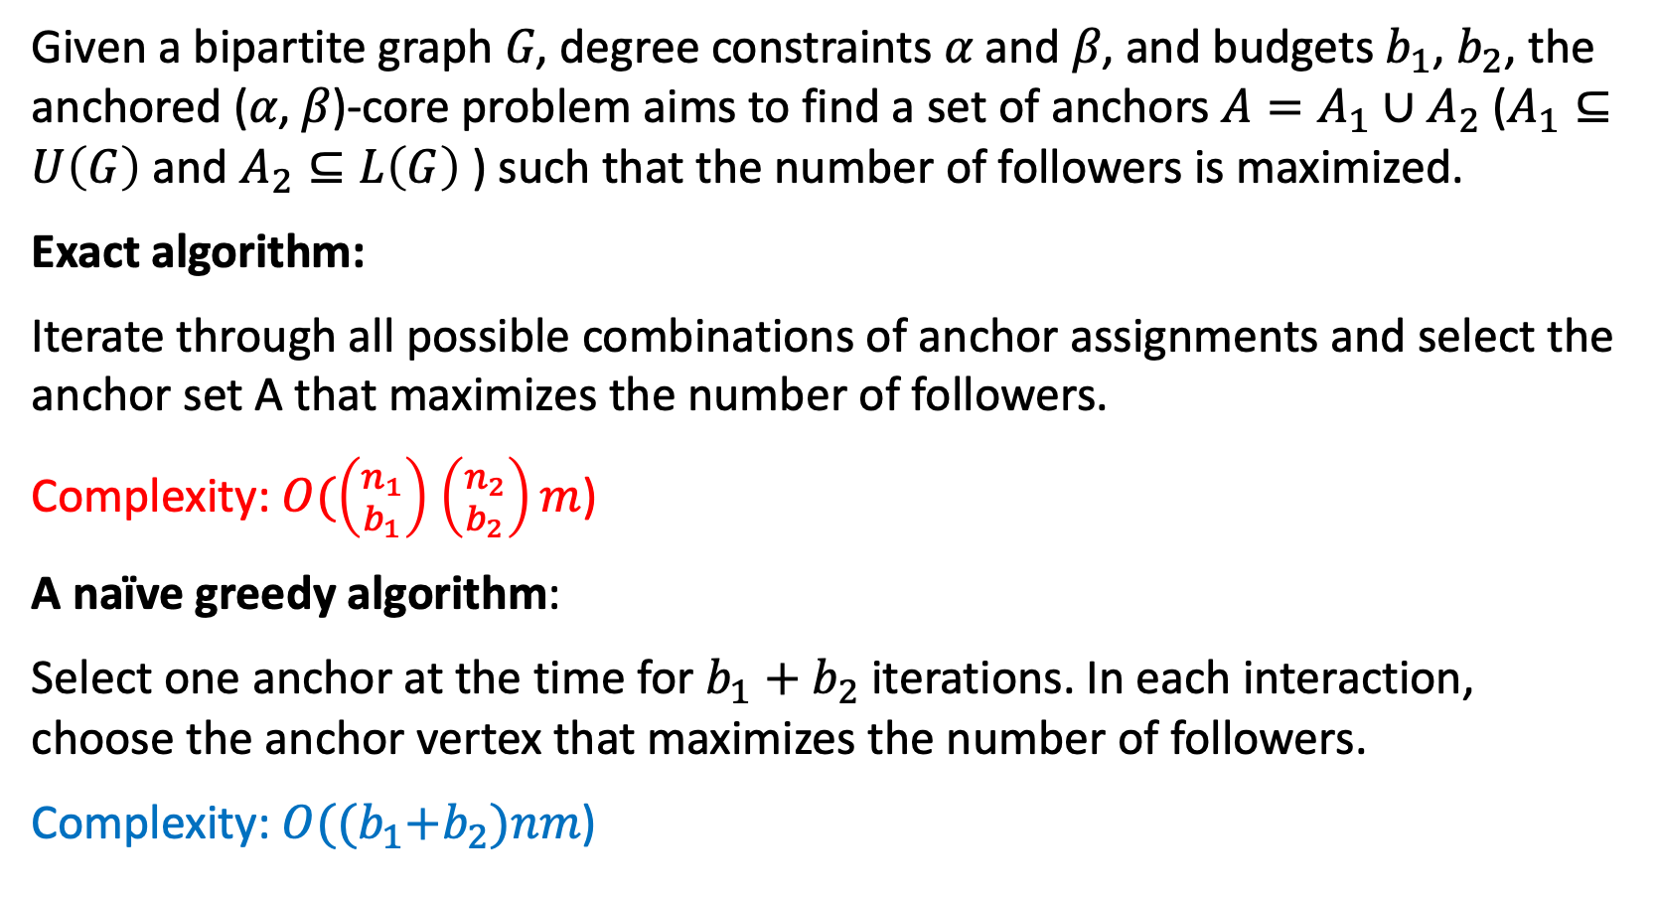
Problem Definition
Given a bipartite graph 𝐺, degree constraints 𝛼 and 𝛽, and budgets $b_{1}$, $b_{2}$, the anchored (𝛼, 𝛽)-core problem aims to find a set of anchors $A=A_{1}∪A_{2}$ ($A_{1}⊆U\left(G\right)$ and $A_{2}⊆L\left(G\right)$ ) such that the number of followers is maximized.
Exact algorithm:
Iterate through all possible combinations of anchor assignments and select the anchor set A that maximizes the number of followers.
Complexity: $O(\left({n_{1} \atop b_{1}}\right)$ $\left({n_{2} \atop b_{2}}\right)m$)
A naïve greedy algorithm:
Select one anchor at the time for $b_{1}+b_{2}$ iterations. In each interaction, choose the anchor vertex that maximizes the number of followers.
Complexity: $O({(b}_{1}+b_{2})nm$)
Notes:
Exact solution: obviously not feasible. Due to combinatorial explosion of the number of possible anchor sets.
Greedy algorithm.
Method, complexity.

Slide 15
Performance Bottleneck of the Naïve greedy algorithm
Bottleneck 1: In each iteration of the greedy algorithm, it needs to process lots of candidate anchors
Bottleneck 2: To compute the followers, we need to traverse the whole graph in the worst case.
Notes:
Bottleneck 1: In each iteration of the greedy algorithm, it needs to process lots of candidate anchors, the number of which is linear to the number of vertices in the
whole graph.
Bottleneck 2: To build the anchor set, we need to compute the followers of each candidate anchor, which needs to traverse the whole graph in the worst case.

Slide 16
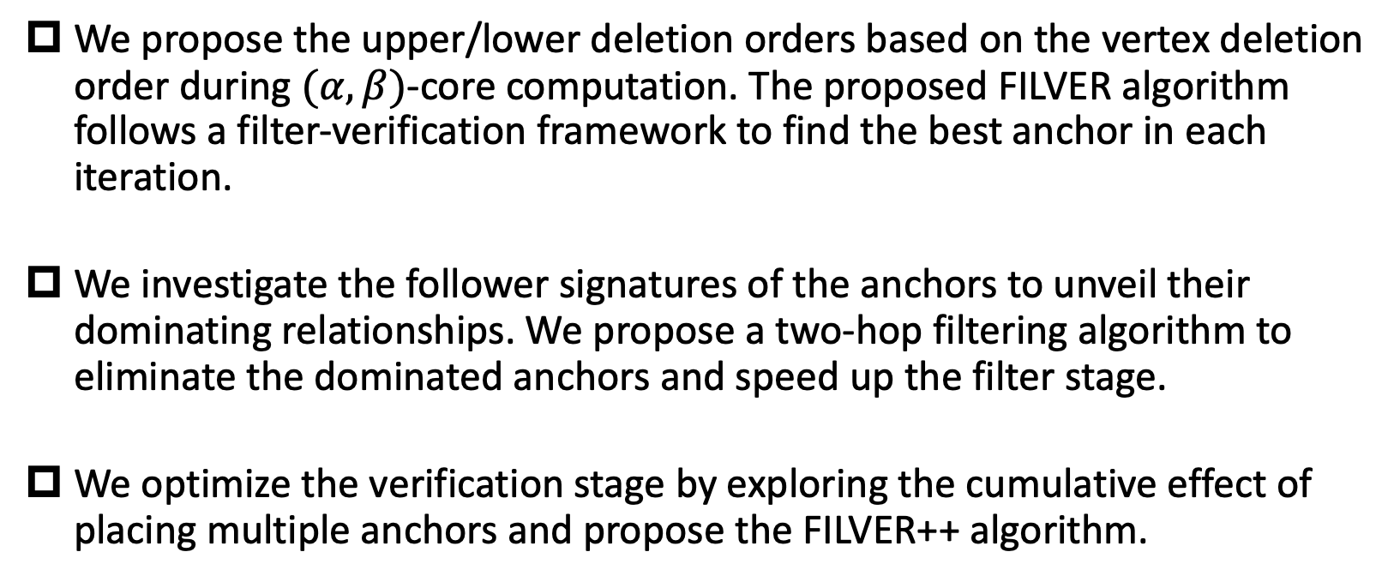
Solution
We propose the upper/lower deletion orders based on the vertex deletion order during $(α,β)$-core computation. The proposed FILVER algorithm follows a filter-verification framework to find the best anchor in each iteration.
We investigate the follower signatures of the anchors to unveil their dominating relationships. We propose a two-hop filtering algorithm to eliminate the dominated anchors and speed up the filter stage.
We optimize the verification stage by exploring the cumulative effect of placing multiple anchors and propose the FILVER++ algorithm.

Slide 17






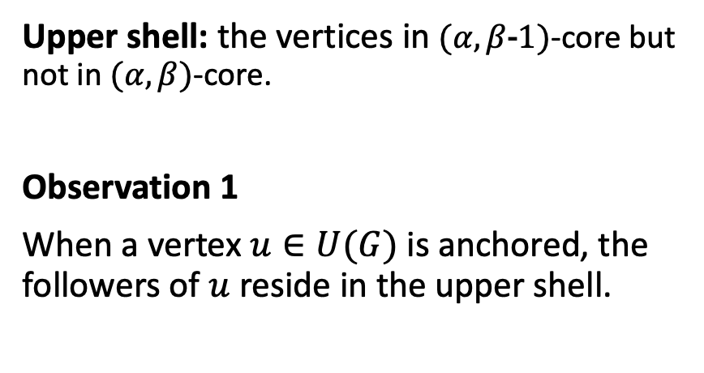




The filter-verification framework
Upper shell: the vertices in $(α, β\text{−}\text{1})$-core but not in $(α, β)$-core.
Observation 1
When a vertex $u∈U(G)$ is anchored, the followers of $u$ reside in the upper shell.
upper vertex
(4, 3)-core
lower vertex
upper shell
$$u_{1}$$
$$u_{3}$$
$$u_{4}$$
$$u_{2}$$
$$u_{5}$$
$$v_{1}$$
$$v_{2}$$
$$v_{3}$$
$$v_{4}$$
$$G$$
Notes:
We start with some simple discussion of where do the followers come from when only one anchor is chosen in each iteration.
When the anchor is in Upper, it turns out that the followers come from the upper shell.
This is because if we consider the anchored abcore wrt to anchor u. If we remove u and its incident edges, the resulting subgraph will be a subgraph of the (a, b-1)-core.
Thus, the followers reside in the (a, b-1)-core.
By this logic, we can also prune away the anchors that do not connect to any vertex in the upper shell.
For example:

Slide 18
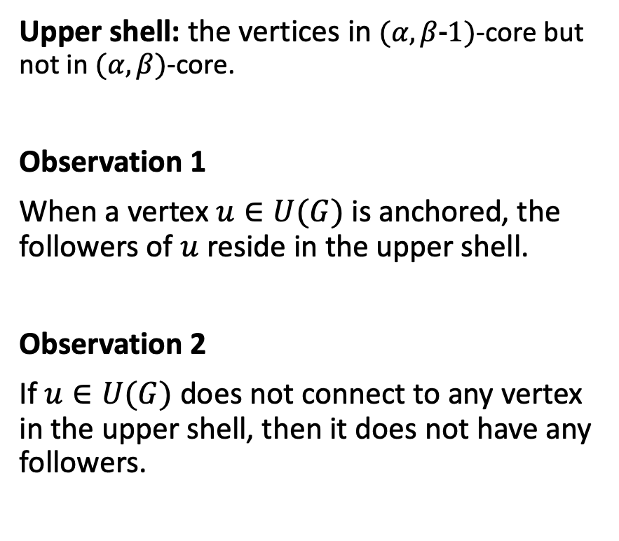
The filter-verification framework
Upper shell: the vertices in $(α, β\text{−}\text{1})$-core but not in $(α, β)$-core.
Observation 1
When a vertex $u∈U(G)$ is anchored, the followers of $u$ reside in the upper shell.
Observation 2
If $u∈U(G)$ does not connect to any vertex in the upper shell, then it does not have any followers.
upper vertex
(4, 3)-core
lower vertex
upper shell
$$u_{1}$$
$$u_{3}$$
$$u_{4}$$
$$u_{2}$$
$$u_{5}$$
promising anchors
$$v_{1}$$
$$v_{2}$$
$$v_{3}$$
$$v_{4}$$
$$G$$
Notes:
We start with some simple discussion of where do the followers come from when only one anchor is chosen in each iteration.
When the anchor is in Upper, it turns out that the followers come from the upper shell.
This is because if we consider the anchored abcore wrt to anchor u. If we remove u and its incident edges, the resulting subgraph will be a subgraph of the (a, b-1)-core.
Thus, the followers reside in the (a, b-1)-core.
By this logic, we can also prune away the anchors that do not connect to any vertex in the upper shell.
For example:

Slide 19




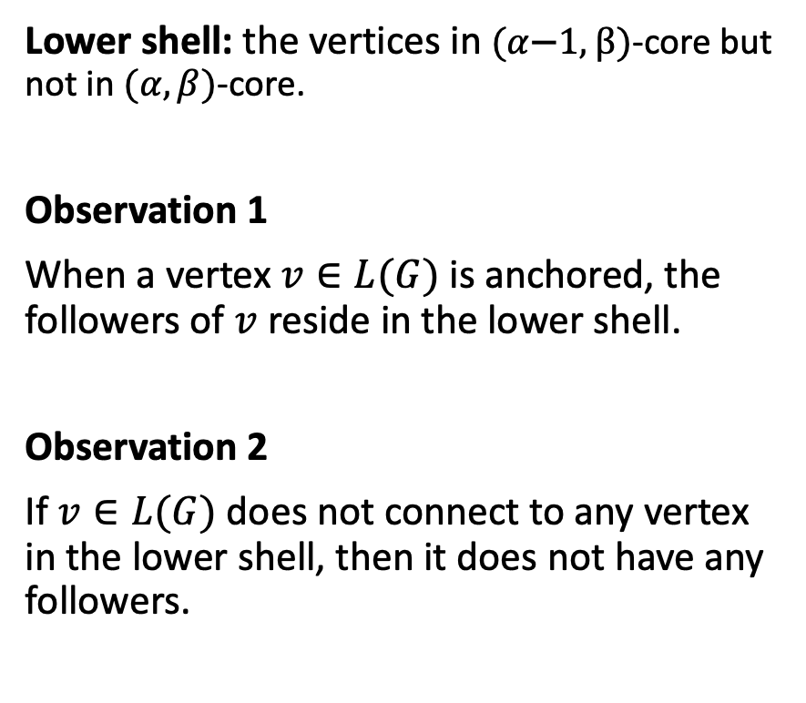
The filter-verification framework
Lower shell: the vertices in $(α\text{−}\text{1}\text{,} β)$-core but not in $(α, β)$-core.
Observation 1
When a vertex $v∈L(G)$ is anchored, the followers of $v$ reside in the lower shell.
Observation 2
If $v∈L(G)$ does not connect to any vertex in the lower shell, then it does not have any followers.
upper vertex
(4, 3)-core
lower vertex
lower shell
$$u_{1}$$
$$u_{3}$$
$$u_{4}$$
$$u_{2}$$
$$u_{5}$$
promising anchor
$$v_{2}$$
$$v_{3}$$
$$v_{4}$$
$$v_{1}$$
$$G$$
Notes:
The same applies to any lower anchor vertex u.
When the anchor is in L(H), it turns out that the followers come from the lower shell.
This is because if we consider the anchored abcore wrt to anchor u. If we remove u and its incident edges, the resulting subgraph will be a subgraph of the (a, b-1)-core.
Thus, the followers reside in the (a, b-1)-core.
By this logic, we can also prune away the anchors that do not connect to any vertex in the upper shell.
For example:

Slide 20






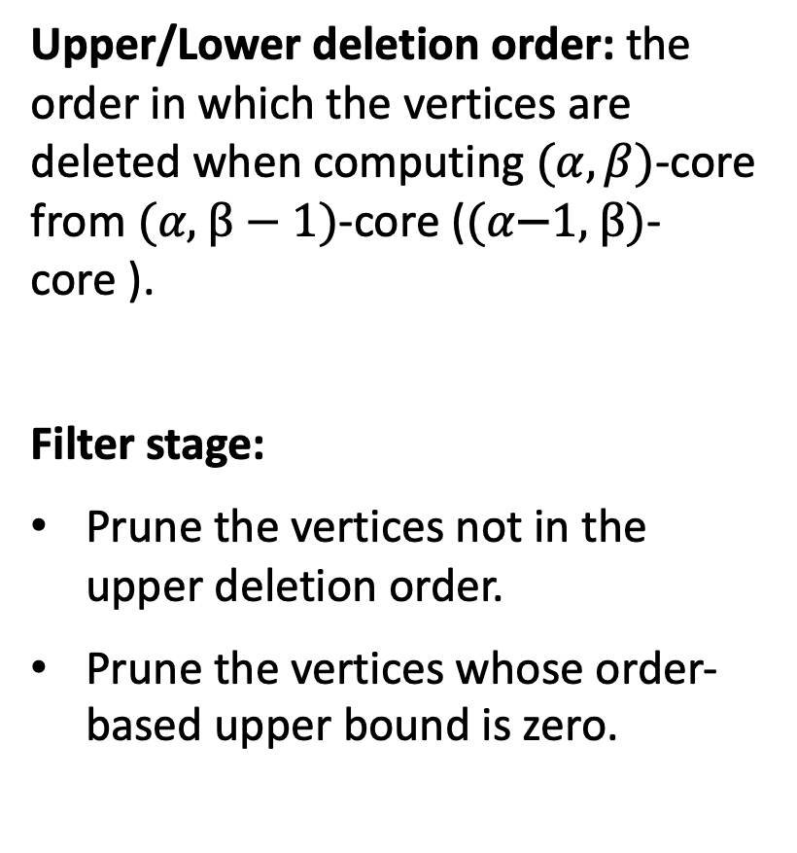




The filter-verification framework
Upper/Lower deletion order: the order in which the vertices are deleted when computing $(α, β)$-core from $(α\text{,} β−1)$-core ($(α\text{−}\text{1}\text{,} β)$-core ).
Filter stage:
Prune the vertices not in the upper deletion order.
Prune the vertices whose order-based upper bound is zero.
$$u_{1}$$
$$u_{3}$$
$$u_{4}$$
$$u_{2}$$
$$u_{5}$$
$$G$$
$$v_{1}$$
$$v_{2}$$
$$v_{3}$$
$$v_{4}$$
Notes:
The above discussion tells us where the followers come from.
We present the filter-verification framework in the context of anchoring one upper vertex.
The order in which the vertices are deleted during abcore computation unveils the dependencies between anchors and followers.
Prune the vertices not in the upper deletion order. These vertices are either in the (α, β)-
core or outside of the (α, β)-core but not connected to any
potential followers.
For example, the vertices in (4,3)-core are of course not considered U1 is also pruned since it does not connect to any vertex in the upper shell.
Prune the vertices whose order-based upper bound is zero.
Based on the order, we can also estimate the upper bound for the number of followers. When the upper bound is zero, the anchor is also pruned.
U3 and u4 are pruned since their order based upper bound are zero.

Slide 21
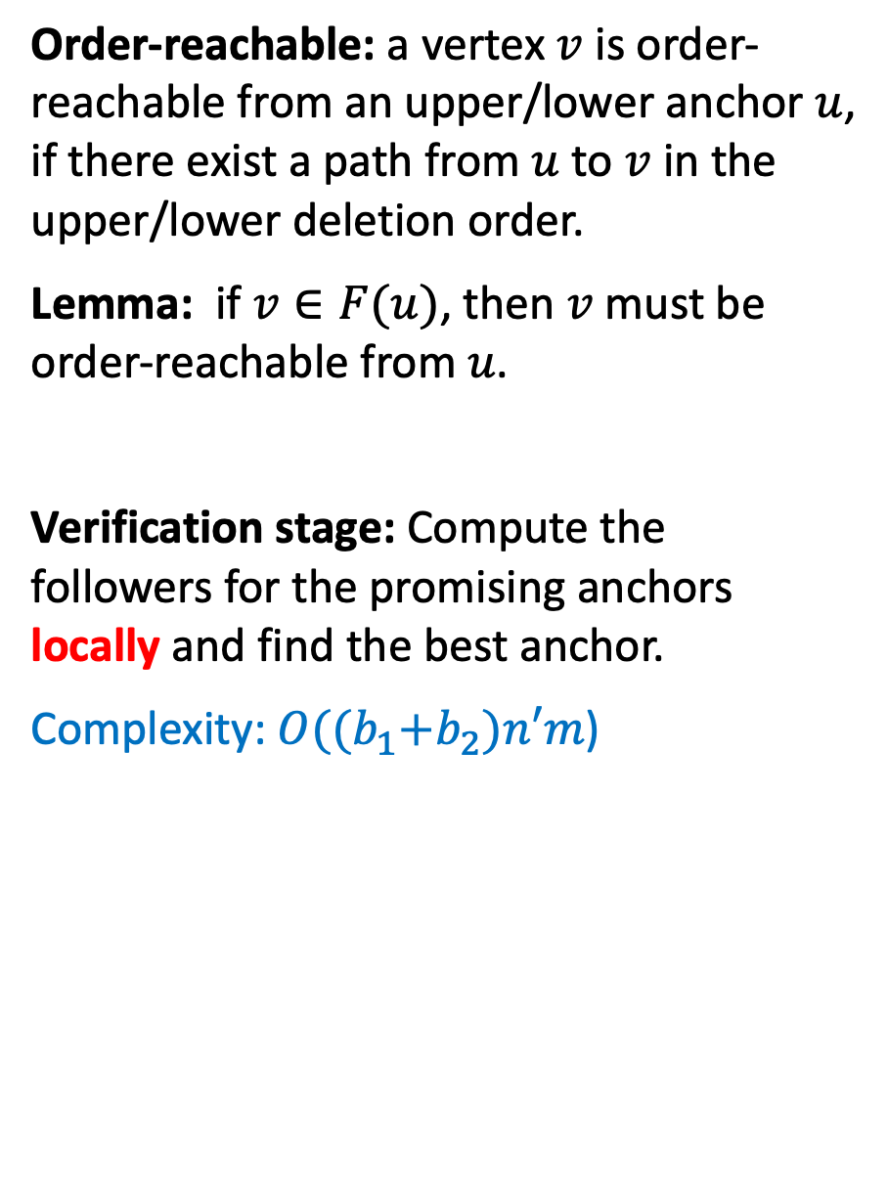
The filter-verification framework
Order-reachable: a vertex $v$ is order-reachable from an upper/lower anchor $u$, if there exist a path from $u$ to $v$ in the upper/lower deletion order.
Lemma: if $v∈F(u)$, then $v$ must be order-reachable from $u$.
Verification stage: Compute the followers for the promising anchors locally and find the best anchor.
Complexity: $O({(b}_{1}+b_{2})n′m$)
$$u_{1}$$
$$u_{3}$$
$$u_{4}$$
$$u_{2}$$
$$u_{5}$$
$$G$$
$$v_{1}$$
$$v_{2}$$
$$v_{3}$$
$$v_{4}$$
Notes:
Observation:
Any follower must be order-reachable from the anchor.
Order-reachability is a necessary but not sufficient condition for being a follower. It can help us limit the scope for follower computation.
Thus, we only need to consider the reachable vertices, which allow us to compute the followers locally instead of globally.
Verification stage:

Slide 22









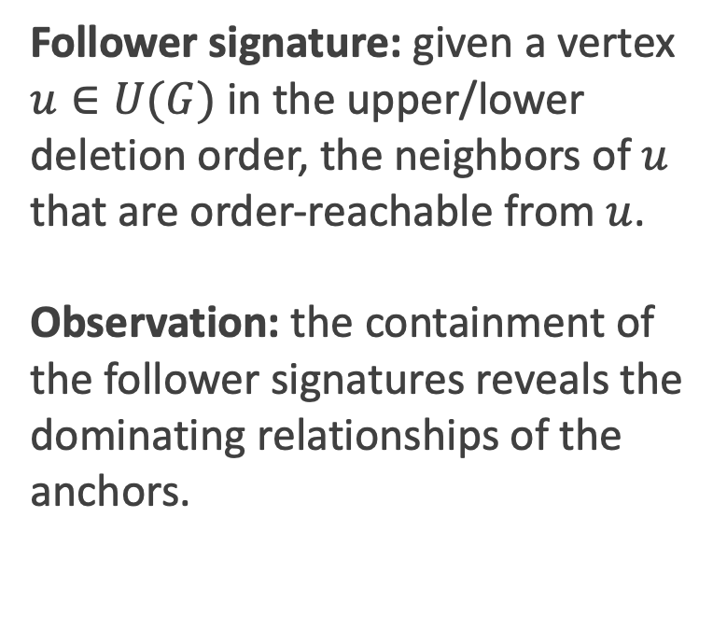




Filter-stage optimizations
Follower signature: given a vertex $u∈U(G)$ in the upper/lower deletion order, the neighbors of $u$ that are order-reachable from $u$.
Observation: the containment of the follower signatures reveals the dominating relationships of the anchors.
$$sig\left(u_{2}\right)=\{v2, v3, v4\}$$
$$sig\left(u_{5}\right)=\{v3, v4\}$$
$$u_{2}$$
$$u_{5}$$
$$u_{2}$$
$$u_{5}$$
$$v_{2}$$
$$v_{3}$$
$$v_{4}$$
$$v_{2}$$
$$v_{3}$$
$$v_{4}$$
$$u_{3}$$
$$u_{4}$$
$$u_{3}$$
$$u_{4}$$
(4, 3)-core
(4, 3)-core
Notes:
In the filter-stage, some unfiltered anchors may be “dominated” by other anchors, which means that their followers are fully covered by others’.
Based on the upper/lower deletion order, we define the follower signature of each anchor vertex.
Which uniquely determines the follower sets.
Also, the containment of sig reveals the dominating relationships
For example, here u2 and u5 are in the upper deletion order.
Sig(u2) contains sig(u5)

Slide 23
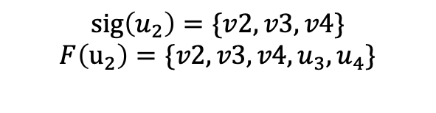
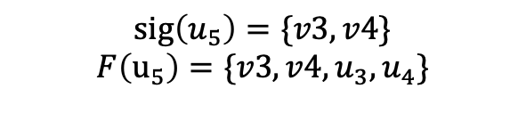
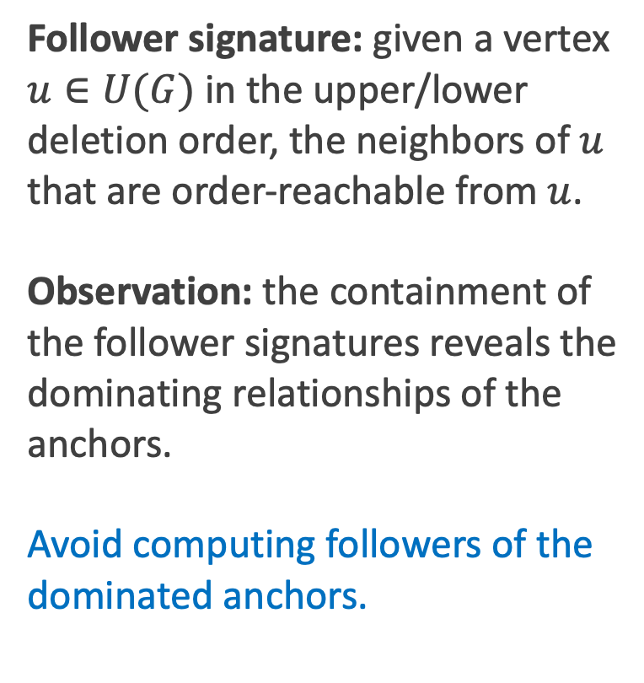

Filter-stage optimizations
Follower signature: given a vertex $u∈U(G)$ in the upper/lower deletion order, the neighbors of $u$ that are order-reachable from $u$.
Observation: the containment of the follower signatures reveals the dominating relationships of the anchors.
Avoid computing followers of the dominated anchors.
$$sig\left(u_{2}\right)=\{v2, v3, v4\}$$
$$F\left(u_{2}\right)=\{v2, v3, v4, u_{3},u_{4}\}$$
$$sig\left(u_{5}\right)=\{v3, v4\}$$
$$F\left(u_{5}\right)=\{v3, v4, u_{3},u_{4}\}$$
$$u_{2}$$
$$u_{5}$$
$$u_{2}$$
$$u_{5}$$
$$v_{2}$$
$$v_{3}$$
$$v_{4}$$
$$v_{2}$$
$$v_{3}$$
$$v_{4}$$
$$u_{3}$$
$$u_{4}$$
$$u_{3}$$
$$u_{4}$$
(4, 3)-core
(4, 3)-core
$u_{2}$ dominates $u_{5}$!
Notes:
For example, here u2 and u5 are in the upper deletion order.
Sig(u2) contains sig(u5).
Based on this, we can conclude that the follower set of u2 contains that of u5.
We can skip computing followers for u5 in this scenario.

Slide 24
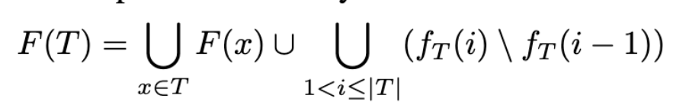
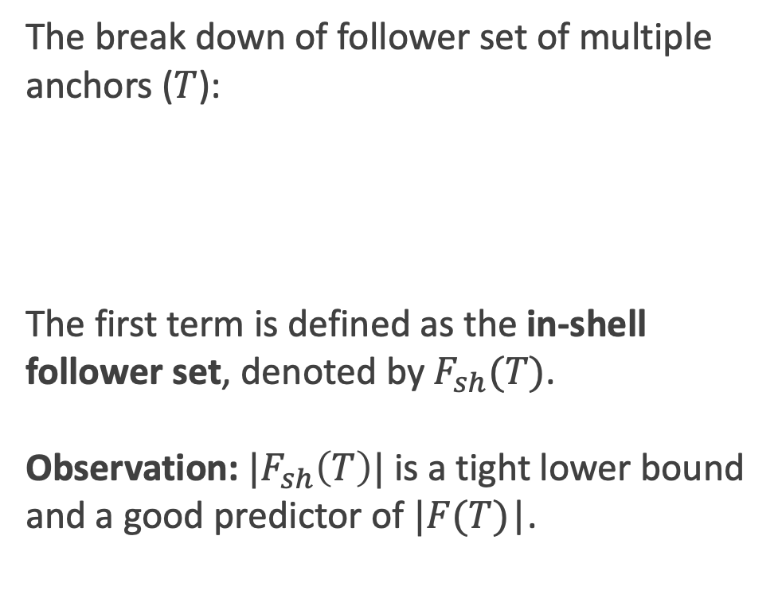
Verification-stage optimizations
The break down of follower set of multiple anchors ($T$):
The first term is defined as the in-shell follower set, denoted by $F_{sh}(T)$.
Observation: ${|F}_{sh}\left(T\right)|$ is a tight lower bound and a good predictor of $|F_{ }(T)$|.
Notes:
We explore the possibility of placing multiple anchors in each iteration while still following the general greedy framework.
When multiple anchors are in play, their followers are no longer the union of the follower set brought by individual anchor.
This is because, as we have proved, the objective function here is not submodular.
We use investigate the xxx like this and break it into two terms. The first term here represent the followers brought by each anchor individually.
The second term is represent the collective effect.
The cardinality of the first term provides us with a lower bound of the size of the actually follower set.
The first plot is the ratio of this lower bound verses the actually follower set. We can see that this ratio is close to 0.8 which is pretty tight.
(on dataset Wikipedia, beta = 7, vary alpha)
The second plot is a scatter plot of this lower bound and the F(x). We can see that they are positively related and it is a good predictor of the follower set.
In each iteration, we resort the maximize the in-shell follower set.

Slide 25
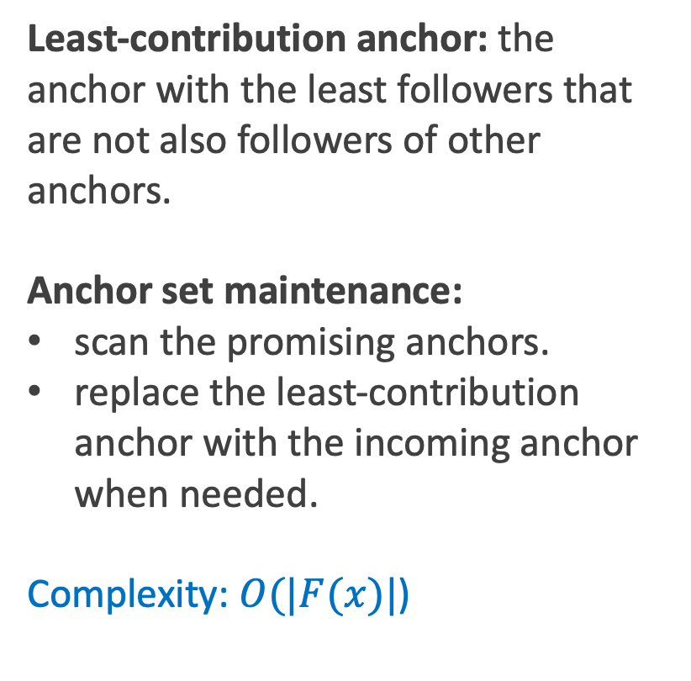
Verification-stage optimizations
Least-contribution anchor: the anchor with the least followers that are not also followers of other anchors.
Anchor set maintenance:
scan the promising anchors.
replace the least-contribution anchor with the incoming anchor when needed.
Complexity: $O(|F(x)|$)
Notes:
To implement this idea, we design an anchor set maintenance algorithm.
For any set of anchors, we identify the lease contribution anchor to be xxxx. It has the least number of followers of its own.
We scan and xxx.
For each incoming anchor, this process takes time linear to the size of follower set.
The time complexity of maintaining this anchor set is bounded by |F(x)|.
Example:

Slide 26
Experiments
Effectiveness evaluation
  A case study on a pollination network
  Compare the greedy algorithm to baselines
Efficiency evaluation
  Efficiency results on different datasets
  Ablation studies on all parameters
  Comparison to the state-of-the-art

Slide 27
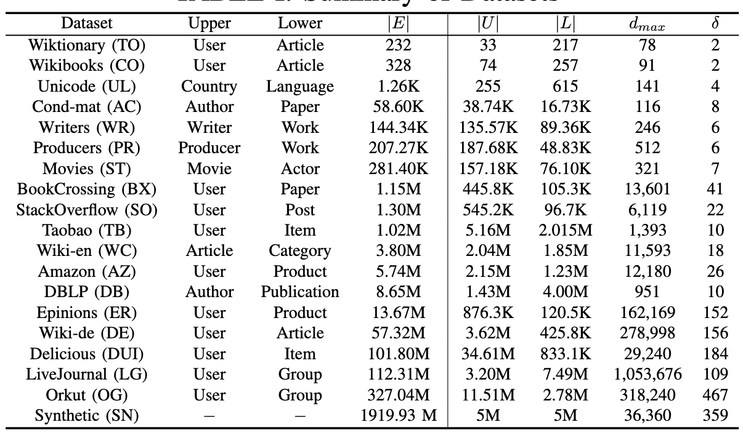
Experimental Settings: Datasets
Notes:
We use 18 real datasets in our experiments. 17 of
them are from KONECT (http://konect.cc/), and Taobao is
a user-item network from the Taobao user-behaviour dataset
(https://tianchi.aliyun.com/),
where each edge represents that
a user has bought an item. To further challenge scalability, a
synthetic graph with 10 million vertices and 4 billion edges
is generated using the well-known graph generator GTgraph
under the Recursive Matrix graph mode

Slide 28
Effectiveness Evaluation
A case study on a pollination network
Notes:
First, we conduct a case study on a “pollination network” of plants and bees.
As shown here.
the pollination network includes 28 species of plants and 53
species of bees.
The 18 black vertices are in the (4, 2)-core,
and the red and blue circled vertices represent upper and
lower anchors.
Due to these 4 anchors, the (4, 2)-
core expands by 56% in size with 3 upper followers and 7
lower followers included
By providing support to these anchored species,
we can significantly enlarge the (α, β)-core and improve the
stability of the pollination networks.

Slide 29
Effectiveness Evaluation
Compare the number of followers of FILVER to other baseline algorithms.
Notes:
here we compare our proposed FILVER algorithm against some baseline approaches and the exact algorothm.
We can see that the algorithms following our greedy framework produce significantly more followers than the degree-based / random assignment.
We can also observe that our greey algorithm produces similar number of followes compared to the exact solution.

Slide 30
Efficiency Evaluation
Performance on different datasets
Notes:
Next, we present the efficiency results.
This figure reports the running time of all greedy algorithms.
We observe that the algorithms under the filter-verification framework (i.e.,
FILVER, FILVER#, FILVER+, and FILVER++) are much faster
than Naive on all datasets.
We also observe that both the filter-stage and verification-
stage optimizations significantly improve the efficiency of
FILVER.

Slide 31
Efficiency Evaluation
Ablation studies on different parameters
Notes:
Here are the abaltion studies on degree constraints and anchor budgets.
As expected, the filter and verification stage optimizations greatly speed up the FILVER algorithm.
On the left, we can see that the running time is inseneitive to degree constraints.
On the right, we can see that the running time is driven up with larger anchor budgets. This is because the algorithms run for more iterations.

Slide 32
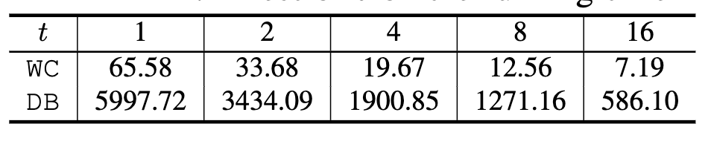
Efficiency Evaluation
Effect of the number of anchors chosen per iteration (t)
Notes:
Here is the ablation study on parameter t, which is the number of anchors placed in each iteration.
We can see that as T goes up. the number of followers produces remain about the same. So effectiveness is preserved.
On the bottom, we can see that with more anchors being placed in each iteration, the total running time drop drastically.

Slide 33
Comparison to the state-of-the-art
The FILVER+ and FILVER++ algorithm can be used to solve the anchored k-core problem.
Notes:
In the end we test our algorithms agains the SOTA for anchore kcore.
We can see that they produce similar number of followers.
The efficiency of OLAK falls in between FIVLER and FILVER++.
This is because FILVER+ needs to compute and
maintain the upper/lower deletion orders to handle all possible
values of α and β and FILVER t chooses multiple anchors in each iteration.

Slide 34
Conclusion
The anchored (𝛼, 𝛽)-core problem. The first work to reinforce bipartite networks using a cohesive subgraph model.
An efficient greedy algorithm under Filter-verification framework.
Filter-stage optimizations by exploring the dominating relationships among anchors.
Verification-stage optimizations by placing multiple anchors in each iteration.
Conduct extensive experiments over 16 real-world graphs and 1 billion-scale synthetic graph to evaluate the effectiveness the efficiency of our algorithms.
Notes:
It would be interesting to see such a model extended to weighted bipartite graphs.
And explore the parallel implementation of the greedy algorithms.

Slide 35
Reference
[1] Fang, Y., Cheng, R., Luo, S. and Hu, J., 2016. Effective community search for large attributed graphs. Proceedings of the VLDB Endowment, 9(12), pp.1233-1244.
[2] Lin, Z., Zhang, F., Lin, X., Zhang, W. and Tian, Z., 2021. Hierarchical core maintenance on large dynamic graphs. Proceedings of the VLDB Endowment, 14(5), pp.757-770.
[3] Liu, B., Yuan, L., Lin, X., Qin, L., Zhang, W. and Zhou, J., 2019, May. Efficient (α, β)-core computation: An index-based approach. In The World Wide Web Conference (pp. 1130-1141).
[4] Liu, B., Yuan, L., Lin, X., Qin, L., Zhang, W. and Zhou, J., 2020. (𝛼, 𝛽)-core computation in bipartite graphs. The VLDB Journal, 29(5), pp.1075-1099.
[5] Huang, X., Cheng, H., Qin, L., Tian, W. and Yu, J.X., 2014, June. Querying k-truss community in large and dynamic graphs. In Proceedings of the 2014 ACM SIGMOD international conference on Management of data (pp. 1311-1322).
[6] Zheng, Z., Ye, F., Li, R.H., Ling, G. and Jin, T., 2017. Finding weighted k-truss communities in large networks. Information Sciences, 417, pp.344-360.
[7] Yuan, L., Qin, L., Zhang, W., Chang, L. and Yang, J., 2017. Index-based densest clique percolation community search in networks. IEEE Transactions on Knowledge and Data Engineering, 30(5), pp.922-935.
[8] Fang, Y., Yu, K., Cheng, R., Lakshmanan, L.V. and Lin, X., Efficient Algorithms for Densest Subgraph Discovery. Proceedings of the VLDB Endowment, 12(11).
[9] Wang, K., Lin, X., Qin, L., Zhang, W. and Zhang, Y., 2019. Vertex Priority Based Butterfly Counting for Large-scale Bipartite Networks. PVLDB.
[10] Wang, K., Lin, X., Qin, L., Zhang, W. and Zhang, Y., 2021. Towards efficient solutions of bitruss decomposition for large-scale bipartite graphs. The VLDB Journal, pp.1-24.
[11] Lyu, B., Qin, L., Lin, X., Zhang, Y., Qian, Z. and Zhou, J., 2020. Maximum biclique search at billion scale. Proceedings of the VLDB Endowment.
[12] Zhang, C., Zhang, W., Zhang, Y., Qin, L., Zhang, F. and Lin, X., 2019, November. Selecting the optimal groups: Efficiently computing skyline k-cliques. In Proceedings of the 28th ACM International Conference on Information and Knowledge Management (pp. 1211-1220).
[13] Li, R.H., Qin, L., Ye, F., Yu, J.X., Xiao, X., Xiao, N. and Zheng, Z., 2018, May. Skyline community search in multi-valued networks. In Proceedings of the 2018 international conference on management of data (pp. 457-472).
[14] Li, Q., Zhu, Y. and Yu, J.X., 2020, April. Skyline Cohesive Group Queries in Large Road-social Networks. In 2020 IEEE 36th International Conference on Data Engineering (ICDE) (pp. 397-408). IEEE.

